Slide 1
Code Clan DevOps Day
Stuart Traynor / Zsolt Podoba-Szalai
May 20

Slide 2
Agenda – Introduction to DevOps
Introduction: 5 minutes 9:15 (Zsolt)
What is DevOps and why now?: 15 minutes (Stuart
Break
Docker 101 Presentation: 20-30 minutes (Stuart)
Docker 101 – Lab: 20 minutes (Zsolt)
Break
Linux 101 Presentation/Lab: 30-40 minutes (Stuart)
Docker 201 – Lab: 30 minutes (Zsolt)
Break
Deploying to cloud services e.g. Heroku – Lab: 40 minutes (Stuart)

Slide 3
What the hell is DevOps?

Slide 4

Traditional Development and Operations
DEV
OPS

Slide 5

“DevOps is development and operations collaboration”
“DevOps is treating your infrastructure as code”
It’s DevOps!
It’s DevOps!
“DevOps is using automation”
It’s DevOps!
“DevOps is feature switches”
It’s DevOps!
“DevOps is small deployments”
“DevOps is Agile?”

Slide 6
Key principles of DevOps
Reduce Organisational Silos
Accept Failure as Normal
Implement Gradual Change
Leverage Tooling & Automation
Measure Everything
Notes:
Developers and IT/Ops professionals had separate (and often competing) objectives, separate department leadership, separate key performance indicators by which they were judged, and often worked on separate floors or even separate buildings. The result was siloed teams concerned only with their own fiefdoms, long hours, botched releases, and unhappy customers.
CM tool: https://www.upguard.com/articles/the-7-configuration-management-tools-you-need-to-know
http://www.testhouse.net/blog/2016/09/01/devops-framework-and-practices/

Slide 7
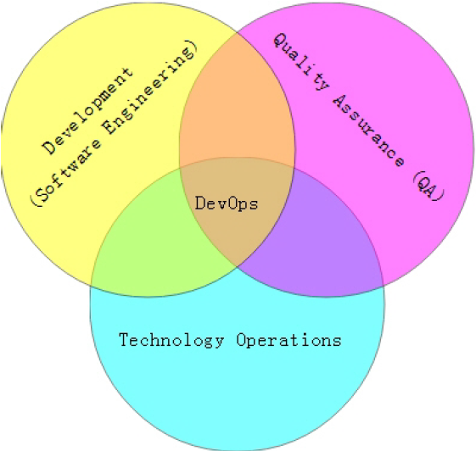
Silos?

Slide 8
Deployment Pipeline
Build
Deployment
Test
Release
Notes:
– Visibility: All aspects of the delivery system are visible to all team members promoting collaboration.
– Feedback:Team members learn of problems as soon as they occur so that issues are fixed as soon as possible.
– Continually Deploy: Through a fully automated process, you can deploy and release any version of the software to any environment.

Slide 9
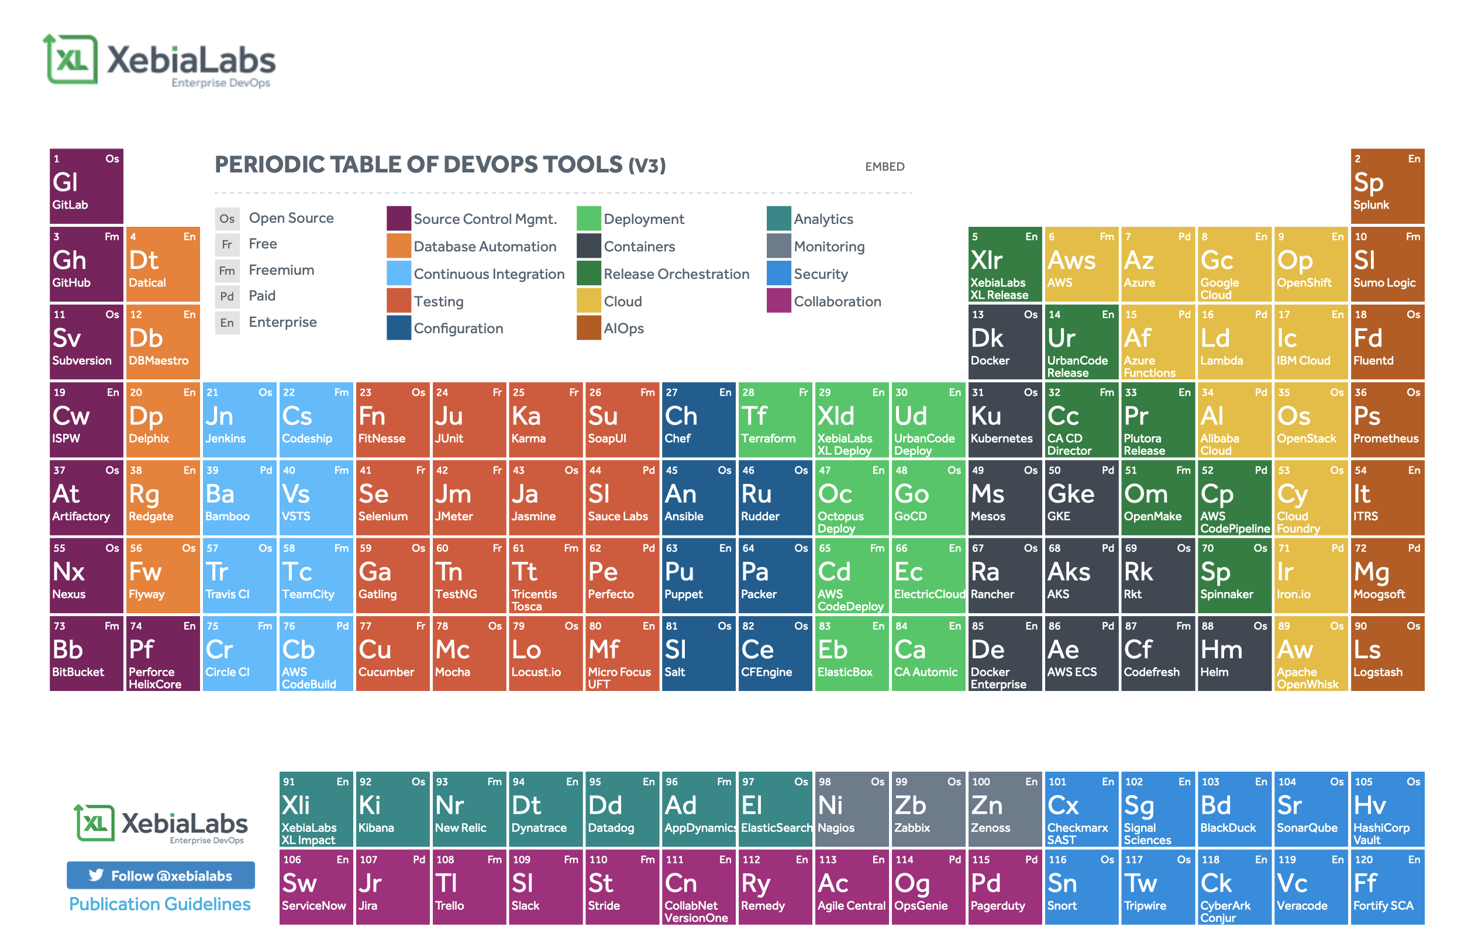
Periodic table of DevOps
https://xebialabs.com/periodic-table-of-devops-tools/

Slide 10
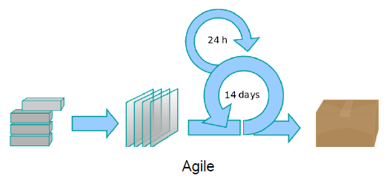
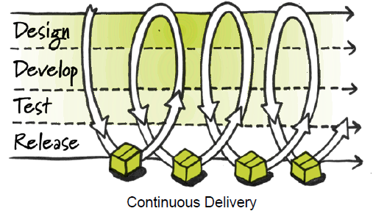
DevOps vs. Agile
DevOps is especially complementary to the Agile software development process.
DevOps enables a far more continuous flow of work into IT Operations.
Notes:
https://thea
extends and completes the continuous integration and release process by ensuring that code is production ready and will provide value to the customer
gileadmin.com/what-is-devops/
If development delivers code every two weeks but it's deployed only every two months, customers don't get value and the deployments often result in chaos and disruption.

Slide 11

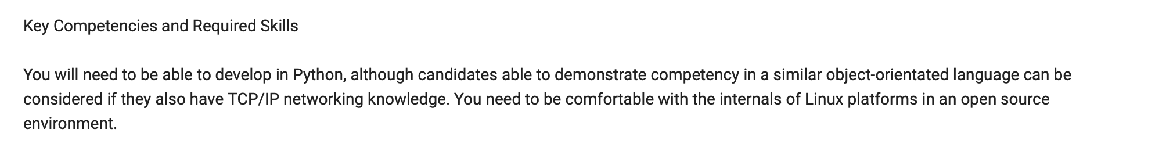
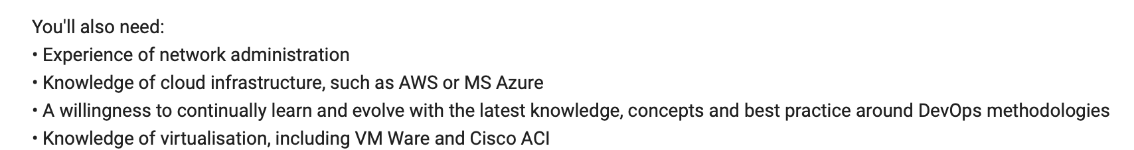
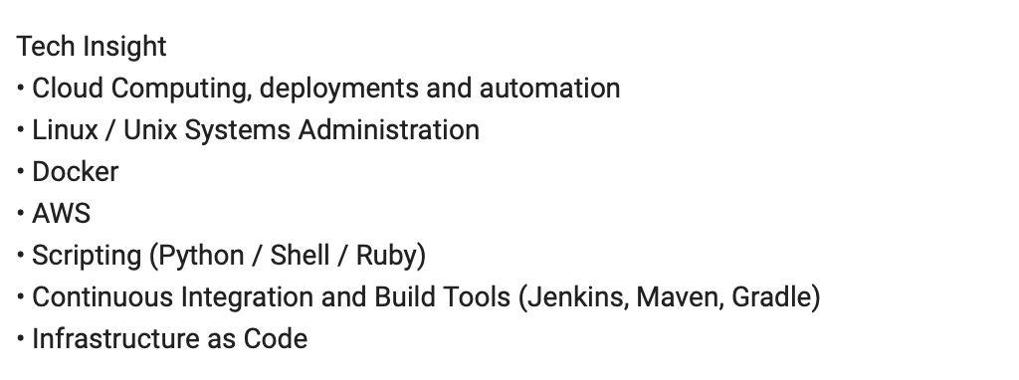

Slide 12

Docker 101
Containers Simplified
Stuart Traynor
Systems Engineer
May 2020

Slide 13
Why Containers, and why Docker?

Slide 14
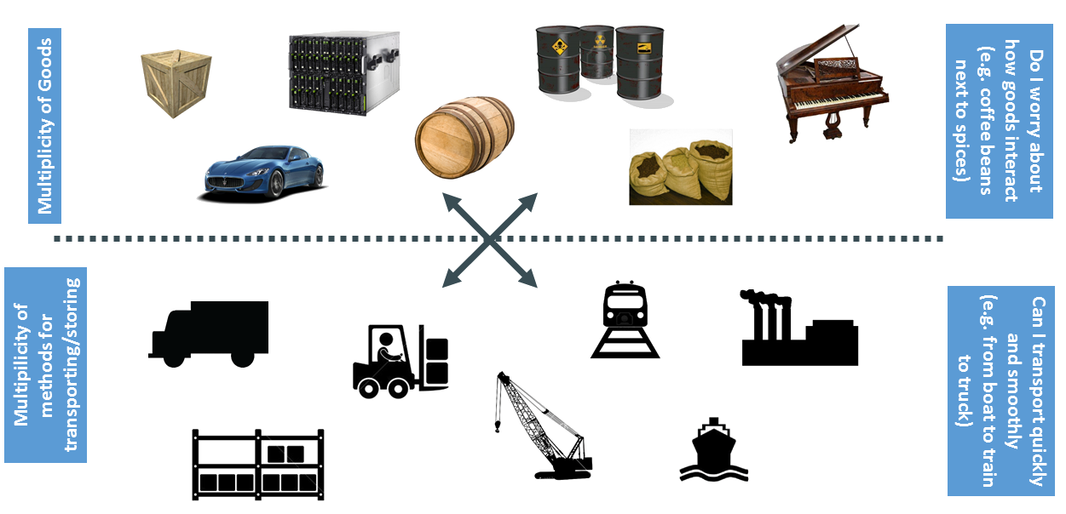
The Cargo Transport problem

Slide 15
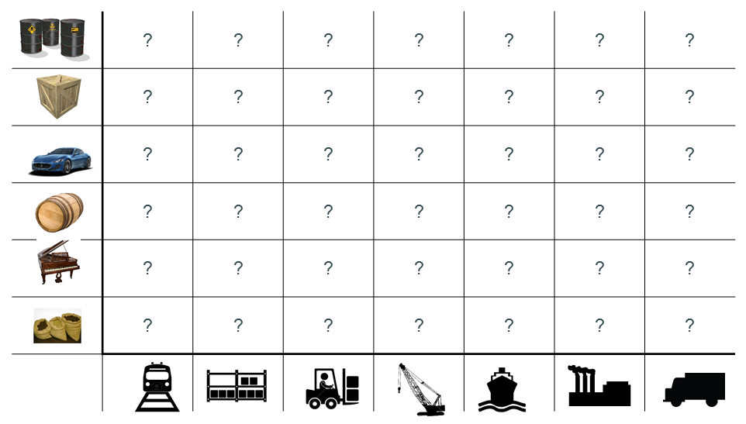
The matrix from hell

Slide 16
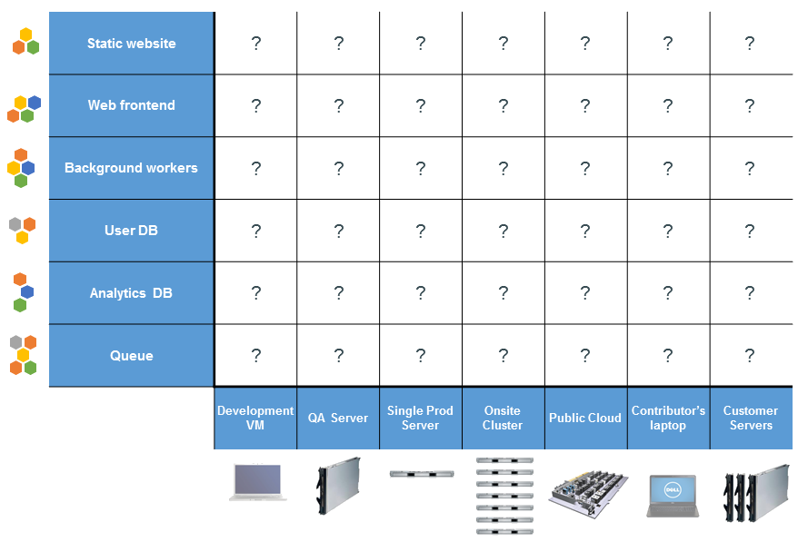
In our terms…

Slide 17
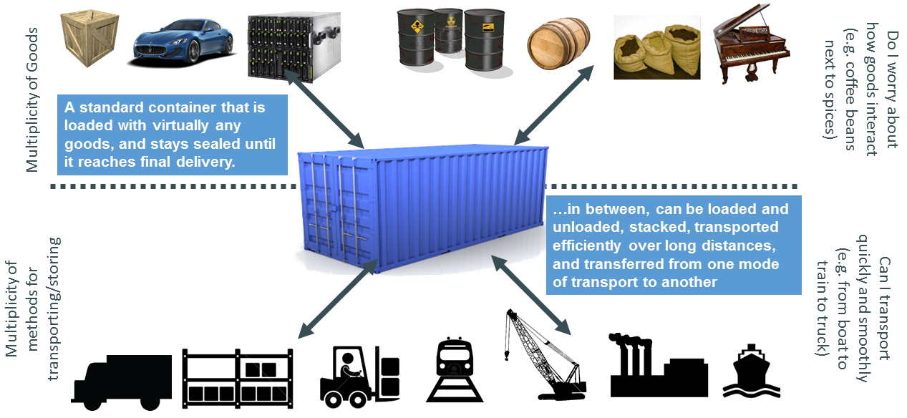
Solution: Intermodal shipping solution

Slide 18
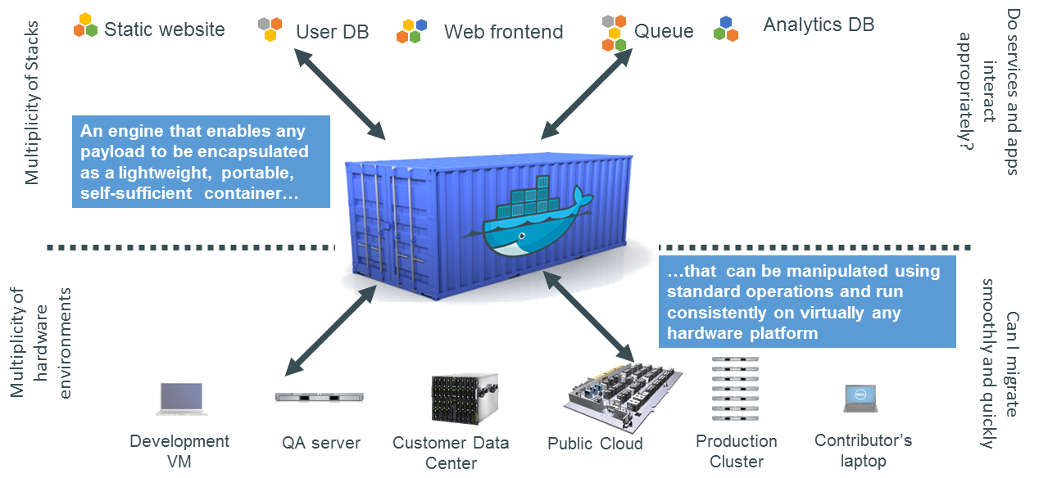
In our terms again…

Slide 19
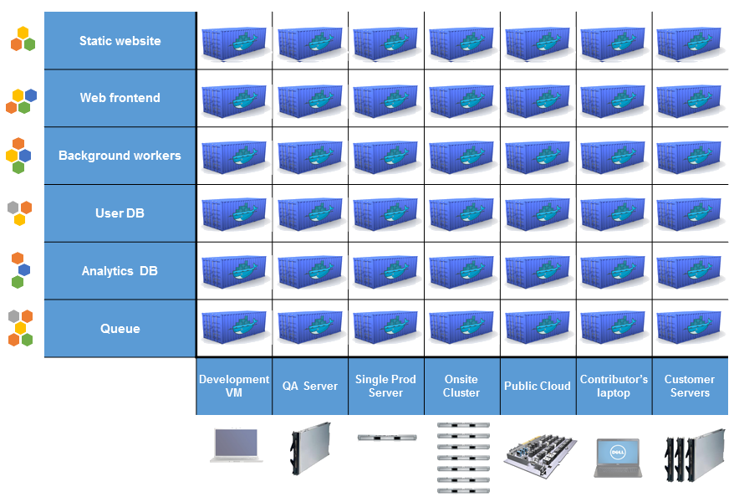
Docker eliminates the Matrix from Hell

Slide 20
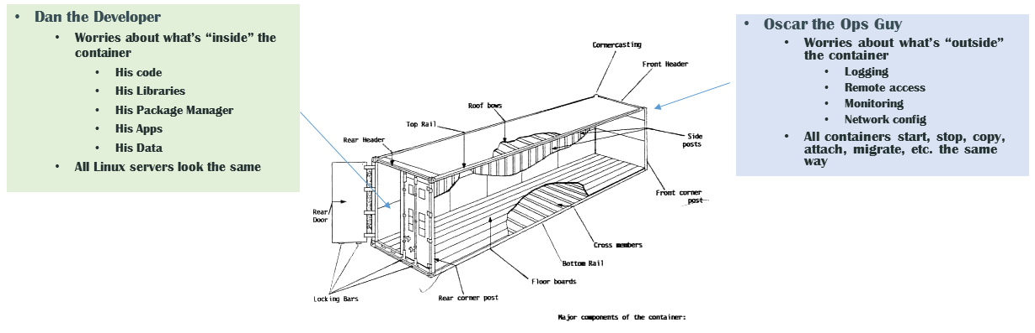
Why it Works: Separation of Concerns

Slide 21
Operating systems
Virtually any distribution with a 2.6.32+ kernel
Red Hat/Docker collaboration to make work across RHEL 6.4+, Fedora, and other members
CoreOS—Small core OS purpose built with Docker

Slide 22
Docker Platform

Slide 23
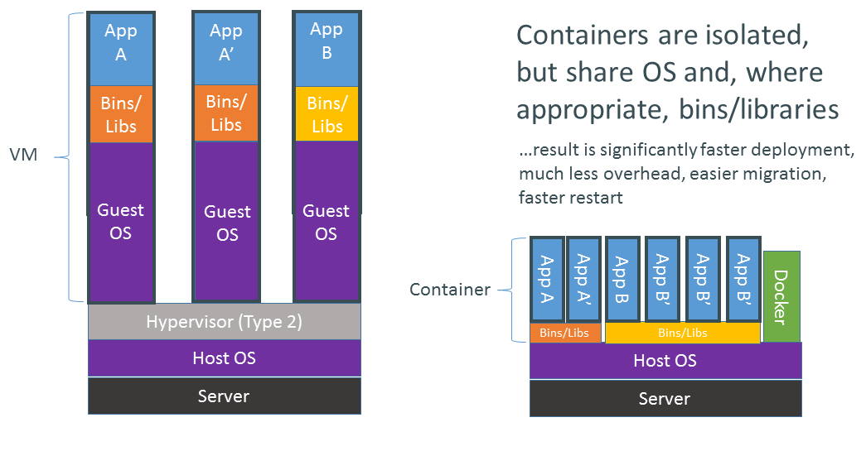
VMs vs Containers

Slide 24
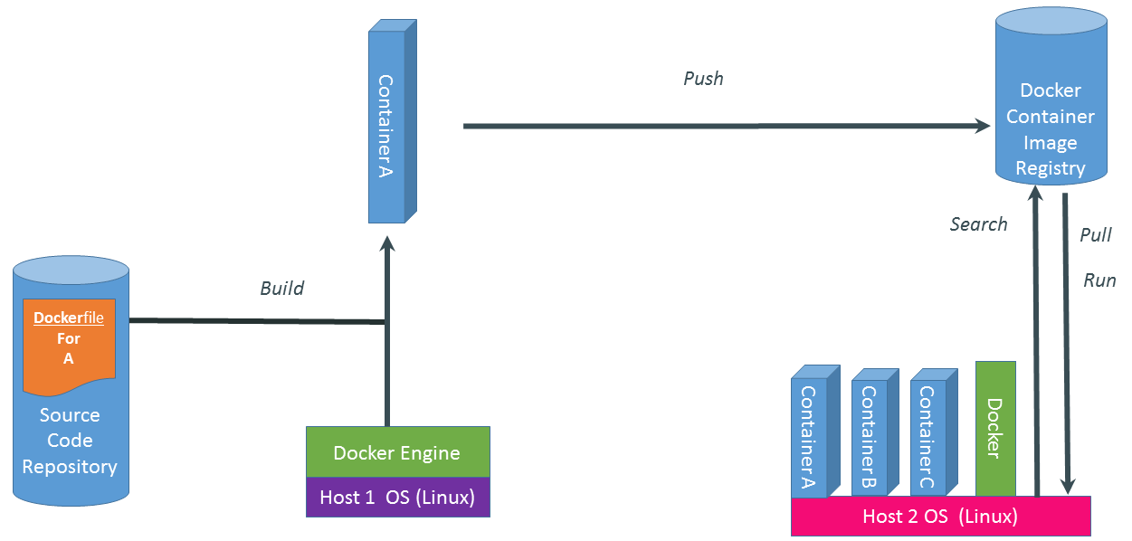
Basics of Docker System

Slide 25
Dockerfile
FROM ubuntu:14.04
MAINTAINER Stuart Traynor sttrayno@cisco.com
RUN apt-get update
RUN apt-get install -y nginx
RUN echo 'Hi, I am in your container' \
> /usr/share/nginx/html/index.htmlCMD ["nginx", "-g", "daemon off;" ]
EXPOSE 80

Slide 26
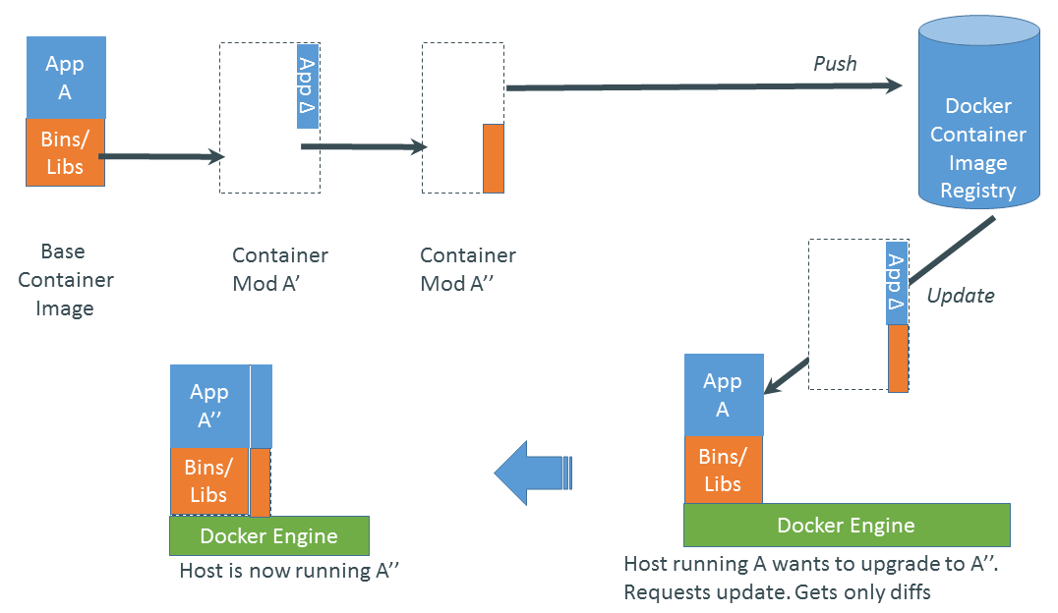
Changes and Updates

Slide 27
The Docker toolchain
BUILD TOOLING
$ docker build .
DISTRIBUTION & VERSIONING
$ docker push
$ docker pull
RUNNING
STANDARD FORMAT
$ docker images
$ docker run

Slide 28
Labs
https://learninglabs.cisco.com/tracks/buildcloudnative/ciscoshipped/docker-101/step/1
https://github.com/imapex-training/mod_adv_docker/blob/master/README.md

Slide 30
Agenda – Introduction to DevOps
Introduction: 5 minutes 9:15 (Zsolt)
What is DevOps and why now?: 15 minutes 9:20
Break
Docker 101 Presentation: 20-30 minutes (Stuart)
Docker 101 – Lab: 20 minutes (Zsolt)
Break
Linux 101 Presentation/Lab: 30-40 minutes (Stuart)
Docker 201 – Lab: 30 minutes (Zsolt)
Break
Deploying to cloud services – Lab: 40 minutes (Stuart)

Slide 31
Linux 101
A refresher for what's to come
Stuart Traynor
Systems Engineer
May 2020

Slide 32
Agenda
Shell
Navigation/Filesystem
Processes
Variables
Intro to VI

Slide 33
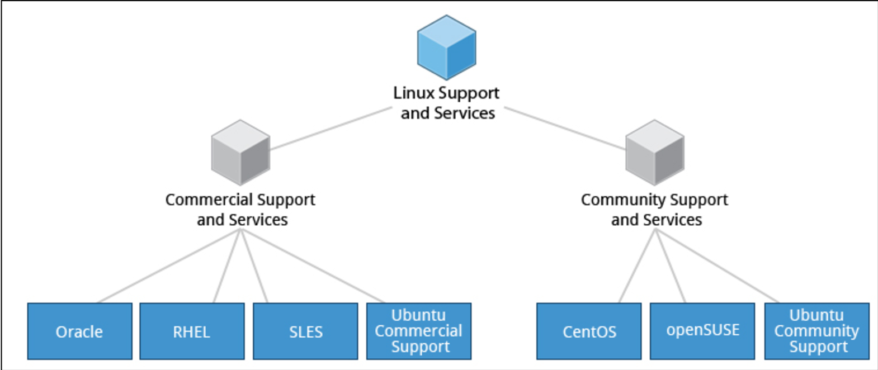
Linux distributions
LinuxFoundationX: LFS101x Introduction to Linux

Slide 34
Directories found on Linux Systems

Slide 35
https://www.blackmoreops.com/2015/02/14/linux-file-system-hierarchy/
Notes:
13 main directories
bin has the essential binaries
boot has the files to bootload the system
etc has host specific configuration
usr has shareable and read only data
var has variable length data files
sbin has system binaries
tmp temproary files
dev device files
home user home directories
lib kernel modules
mnt mount files for temporary file systems
opt
root

Slide 36
What is the shell?

Slide 37
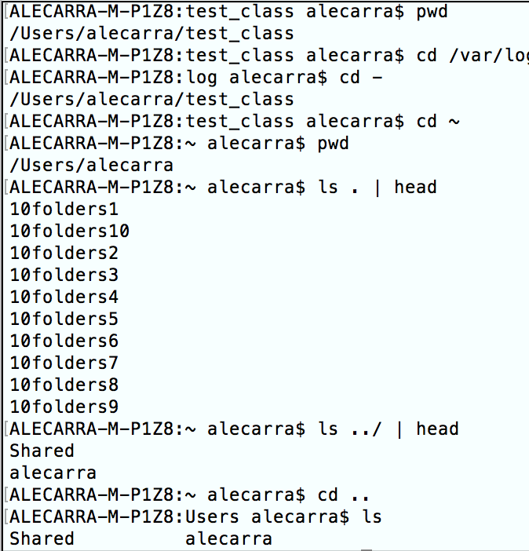
Navigation
pwd
cd
cd –
cd ~
ls
Absolute path names (/home/user)
Relative path names
. → working directory
.. → working directory’s parent directory
Notes:
Cd changes the working directory to your home directory
Cd – changes the working directory to your previous working directory
Cd ~alecarra changes the current working directory to the home of the username
An absolute pathname begins with the root directory and follows the tree branch by branch until the path to the desired directory or file is completed.

Slide 38
Navigation
.filename → shown with ls –a
Case sensitive
No file extensions (.exe)
Do not embed spaces in filenames
Notes:
.filename is because the filename is a hidden file

Slide 39
Exploring the system
ls → list directory contents
ls /usr
ls –l → will give more details. (l = long format)
file → determines file type
less → view file contents
Notes:
ls
ls /usr
ls /usr ~
ls –l → will give more detail

Slide 40
Exploring the system ls Options and arguments
Option | Long option | Description
-a | --all | List all files (even the hidden files)
-d | --directory | Used in conjunction with –l you can see the details of the directory rather than only its contents.
-F | --classify | Appends an indicator to the end of each listed name
-h | --human-readable | Displays file sizes in human-readable format (not bytes)
-l |  | Displays results in long format
-r | --reverse | Displays results in reverse order (originally in alphabetical order)
-S |  | Sort results by file size
-t |  | Sort by modification time

Slide 41
Exploring the system - Long listing fields
Meaning
Access rights to the file.
File’s number of hard links
The user name of the file’s owner
The name of the group that owns the file
Size of the file in bytes
Date and time of the file’s last modification
Name of the file
Notes:
- Indicates file
d indicates directory

Slide 42
Manipulating files and directories
cp – copies files and directories
mv – moves/renames files and directories
mkdir – creates directories
rm – removes files and directories
ln – creates hard and symbolic links
Notes:
Flexibility is better by doing this rather than the cli.
Like you can’t cp –u *html destination

Slide 43
Manipulating files and directories - wildcards
Pattern | Matches
* | All files
g* | Any file beginning with g
b*.txt | Any file beginning with b followed by any characters and ending with .txt
Data??? | Any file beginning with Data followed by exactly 3 characters
[abc]* | Any file beginning with either a, b or c
BACKUP.[0-9][0-9][0-9] | Any file beginning with BACKUP. Followed by exactly three numerals
[[:upper:]]* | Any file beginning with an uppercase letter
[![:digit:]]* | Any file not beginning with a numeral
*[[:lower:]123] | Any file ending with a lowercase letter or the numerals 1,2 or 3
Notes:
Wildcards
*
?
[characters]
[!characters]
[[:class:]]
Classes
[:alnum:] alphanumeric
[:alpha:] alphabetic
[:digit:] numeric
[:lower:] lowercase letter
[:upper:] uppercase letter

Slide 44
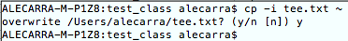
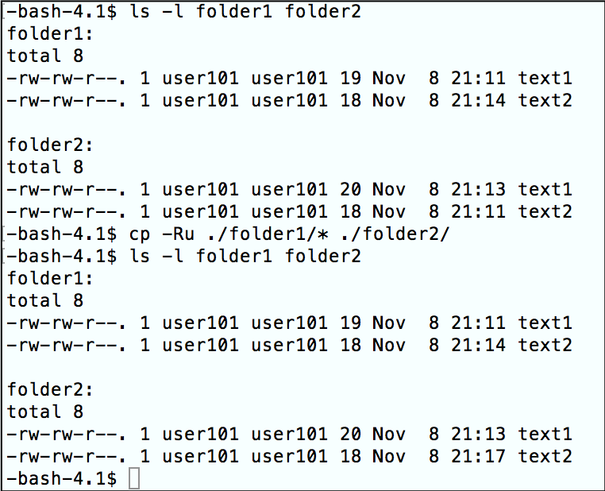
Manipulating files and directories CP options
Option | Meaning
-a, --archive | Copy files and directories and all of their attributes
-i, --interactive | Before overwriting an existing file, prompt for confirmation
-r, --recursive | Recursively copy directories and their contents
-u, --update | Copy only files that either don-t exist or are newer than the existing corresponding files in the destination directory
-v, --verbose | Display informative messages as the copy is performed
Notes:
-a → Normally copies take a on the default attributes of the user performing the copy
-I → default is not to ask
-r → this is required when copying directories
First list the content of folder1 and folder 2, check the time of the files
Then i´m copying everything that is under fodler1 to folder2 only if it is newer than the content of folder2
The only file that was newer was text2, thus it was the only file that was copied

Slide 45
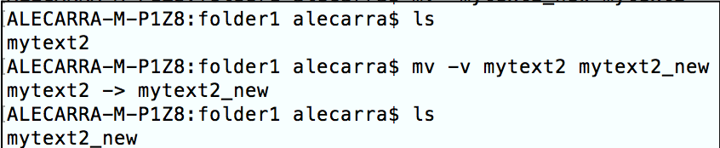
mv – move
In its first form, the mv utility renames the file named by the source operand to the destination path named by the target operand.
This form is assumed when the last operand does not name an already existing directory.

Slide 46
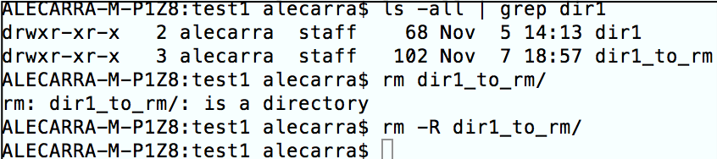
Working with commands rm – remove.
Whenever using rm, test with ls so you’ll see what you’re going to remove.
-f, --force → Ignore nonexistent files and do not prompt
Notes:
Note that if you have directories you need to use –R to make it recursive, otherwise it won´t let you delete the folder

Slide 47
Permissions

Slide 48
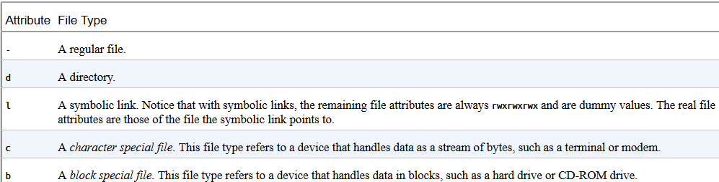
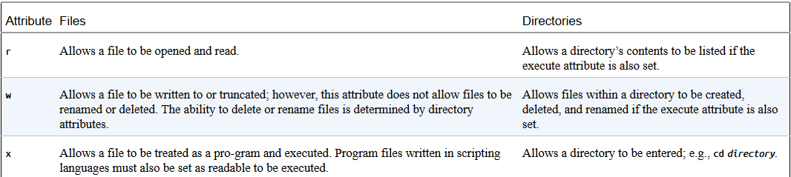
Reading, Writing and executing
root@ubuntu:/home/alecarra/Documents# ls -l dumbtext1
-rw-rw-r-- 1 alecarra alecarra 40403 Oct 3 18:22 dumbtext1
File type
Owner permissions
Group permissions
World permissions
Shotts, W. E. (2012). The Linux command line: William Pollock

Slide 49
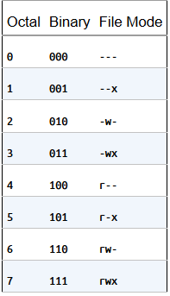
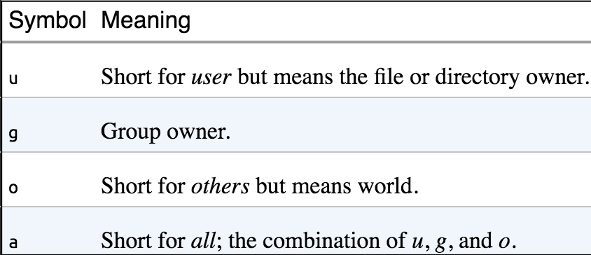
Changing file mode
Chmod -- can only be used by the file’s owner or super user.
Octal representation
Symbolic representation
Shotts, W. E. (2012). The Linux command line: William Pollock

Slide 50
Processes

Slide 51
Processes
It is just how linux organises the different programs waiting for their turn at the CPU.
ps – report a snapshot of current processes
top – display tasks
jobs – list active jobs
bg – place a job in the background
fg – place a job in the foreground
Kill – send a signal to a process
killall – kill processes by name
Notes:
System starts -> init located in /etc init scripts start all the system services (many are daemon programs)
Each process has a process id (pid)
Init is pid 1
Kernel keeps track of memory assigned to each process

Slide 52
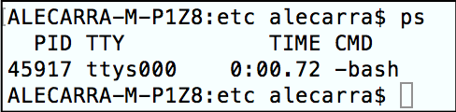
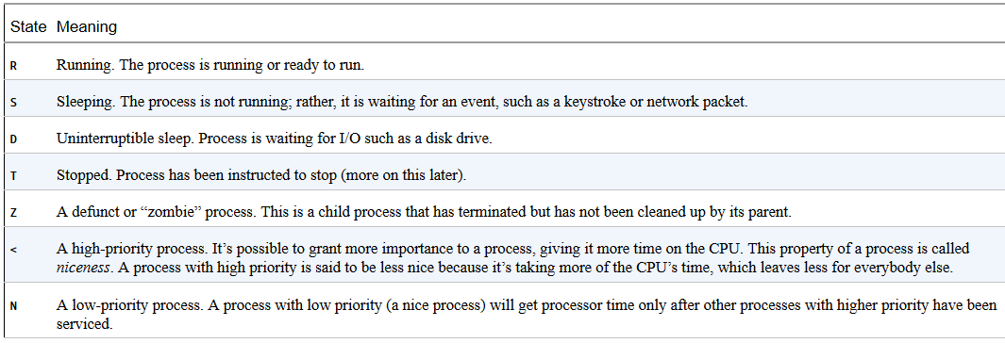
Processes - ps
ps
ps x → shows all our processes regardless of what terminal they are controlled by
Shotts, W. E. (2012). The Linux command line: William Pollock
Notes:
Ps only shows the processes associated with the current terminal session
Tty is short for teletype
Pid process id
Time is the ammount of cpu time consumed by the process
? Means no controlling terminal
Stat = state

Slide 53
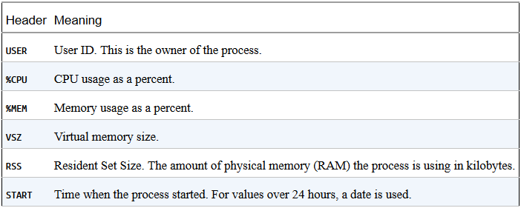
Processes - ps
Ps aux → adds more information
Shotts, W. E. (2012). The Linux command line: William Pollock
Notes:
Time is the ammount of time consumed by the process
? Means no controlling terminal
Stat = state

Slide 54
top
Lets you see a more dynamic view of the machine-s activity
Displays a continuously updating display of the processes sorted in process activity
Notes:
Ps only gives you a snapshot of the machine-s state at the moment the command is executed

Slide 55
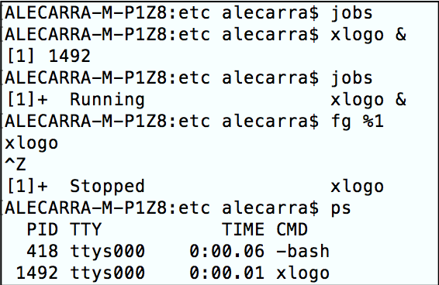
Jobs
List the jobs that have been launched from our terminal
Xlogo & → sends it to the background
Jobs
Fg %1 → sends it to the foreground
Ctrl + z → stops the process (TSTP)
% points to the job
Notes:
Ctrl + sends the signal INT (interrupt)
Tstp is terminal stop
With % you are referring to the jobs

Slide 56
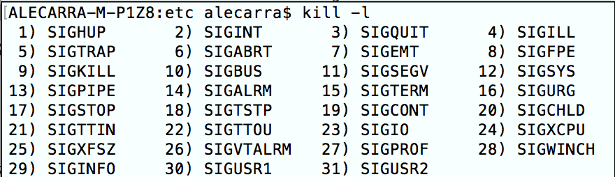
Signals
Kill [-signal] pid
1 Hang up
2 Interrupt
9 Kill
15 Term
18 Cont
19 Stop
You can use signals by number or name SIG<signal>
Kill –l → will give you a complete list of signals
Notes:
Killall [-u user] [-signal] name only if youre root

Slide 57
System and Environment Variables

Slide 58
The environment
It is the information maintained during our shell session and it is used by programs to determine facts about configuration.
Printenv — Print part or all of the environment.
Set — Set shell options.
Export — Export environment to subsequently executed programs.
Alias — Create an alias for a command.

Slide 59
The environment
Environment variables
Non shell variables
Shell variables
Bits of data placed there by bash
Aliases
Shell functions

Slide 60
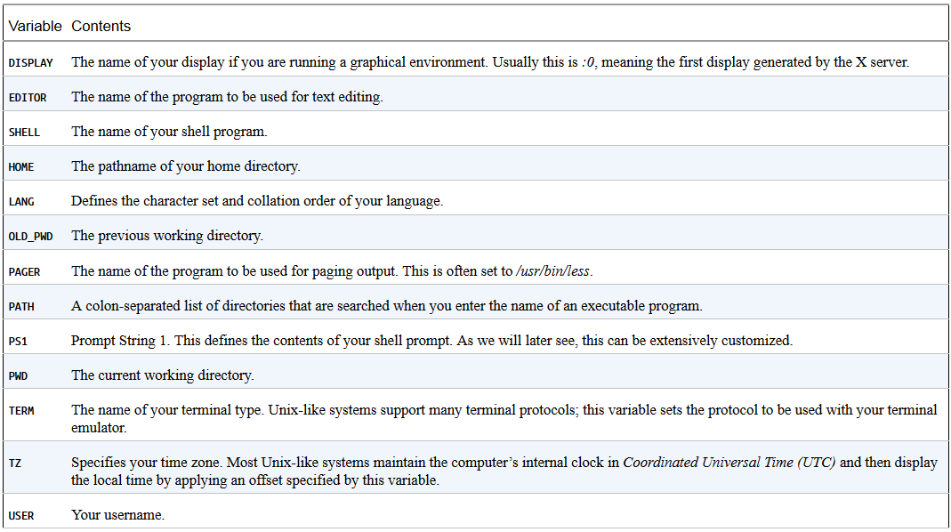
Interesting variables
Shotts, W. E. (2012). The Linux command line: William Pollock

Slide 61
Environment
Path is often set by /etc/profile

Slide 62
Intro to VI

Slide 63
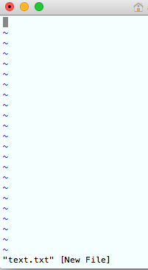
Intro to VI
vi text.txt
There is no text in this line
Name of the file we opened
Vi starts in command line

Slide 64
VI
Etnering insert mode (i)
-- INSERT –
Exiting insert mode (ESC)
: → ex command
Saving our work (w)
"text.txt" [New] 1L, 42C written

Slide 65
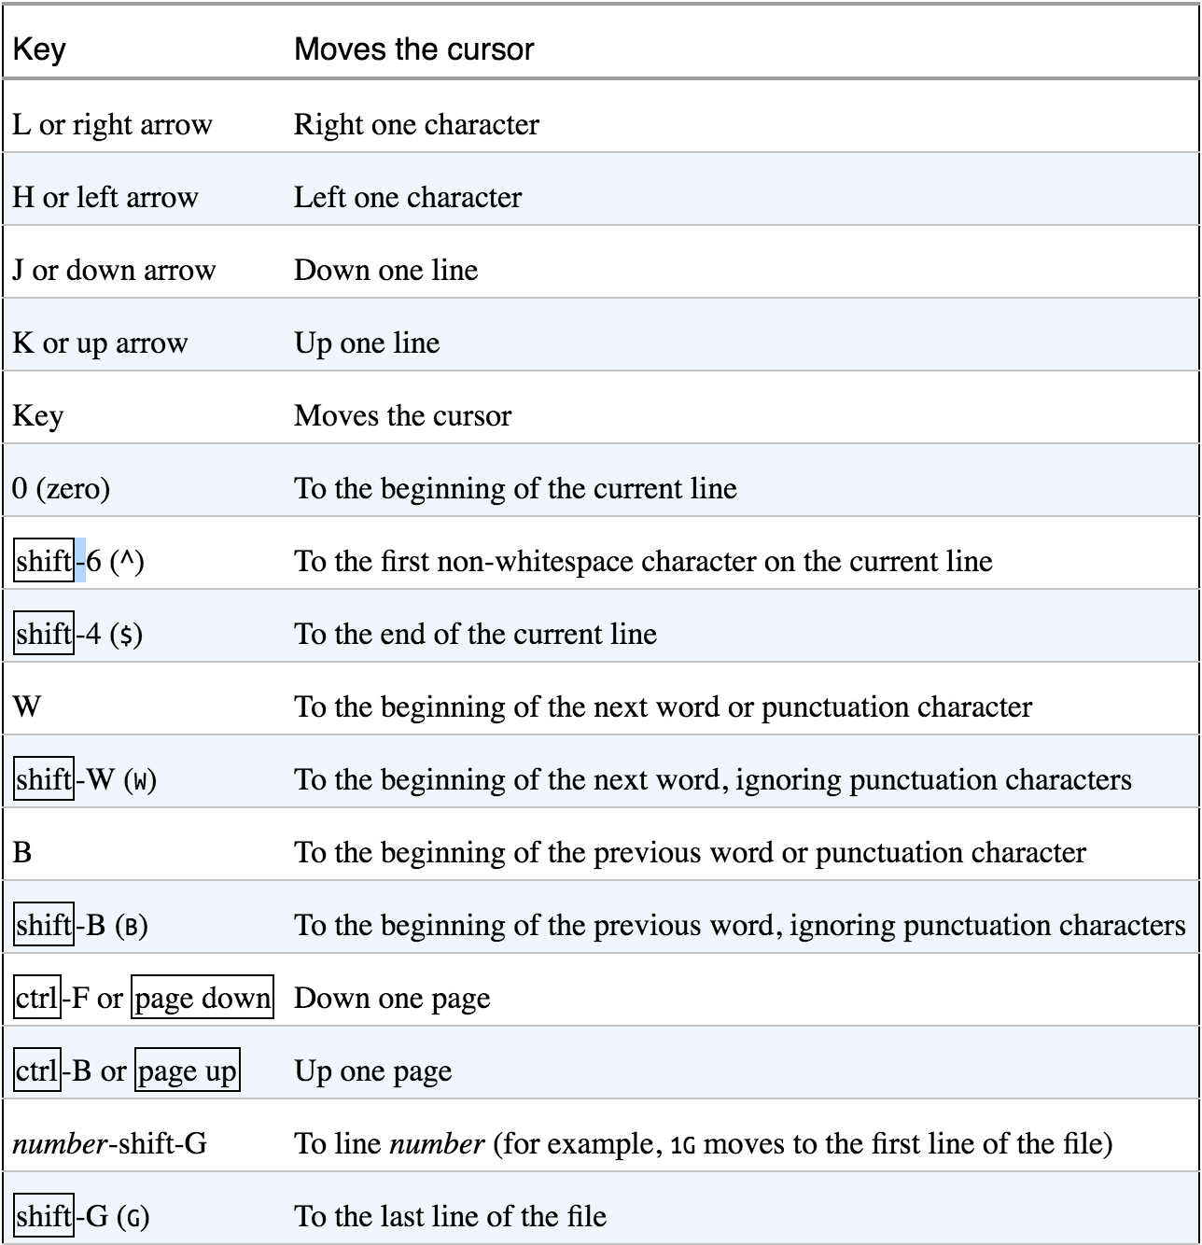
Moving the cursor
Shotts, W. E. (2012). The Linux command line: William Pollock
Notes:
Many commands can be prefixed such as 5J which will go up 5 lines

Slide 66
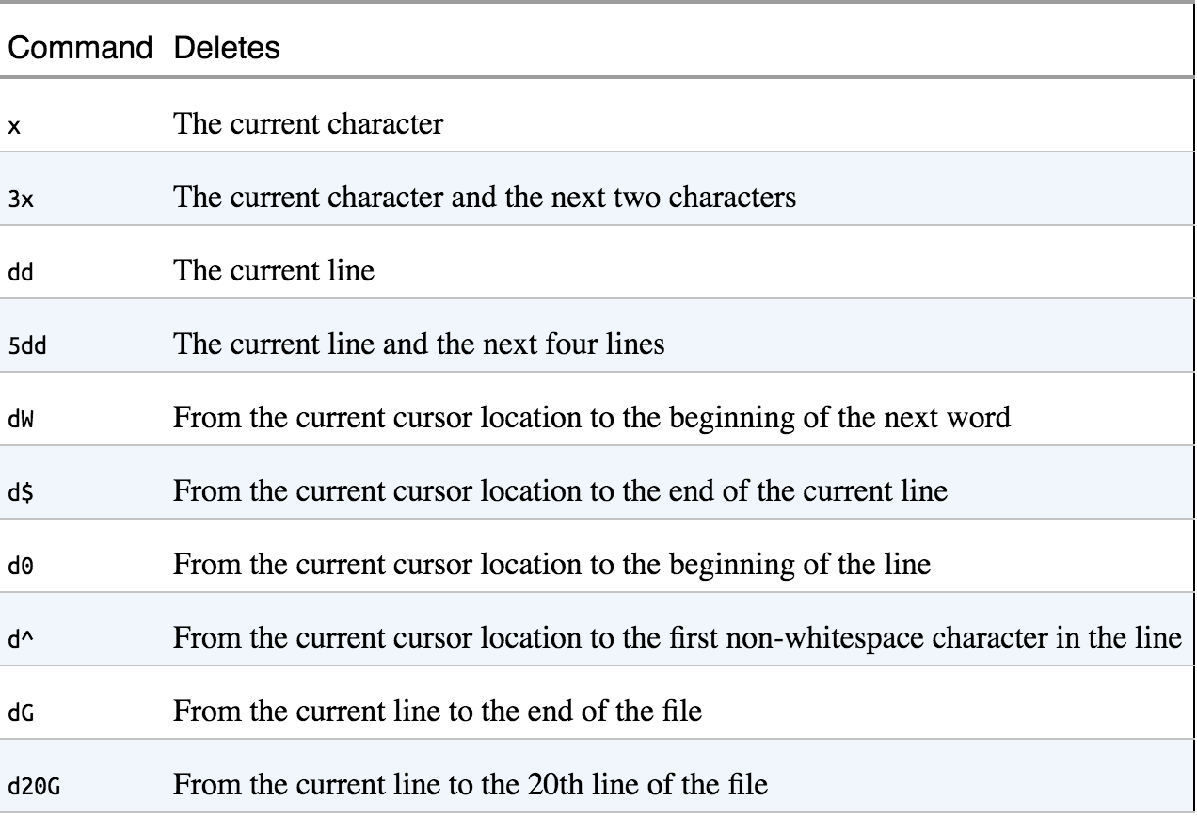
Deleting text
Shotts, W. E. (2012). The Linux command line: William Pollock
Notes:
Undo is with u in command mode
Moving to the beginning of the line is with 0
Appending text to the end of the line is with A … a will take you to the next character of where the cursor is
o will add the line below and O after

Slide 67
Editing text
Undo u
Moving to the beginning of the line 0
Appending text a or A
Adding a line (o or O)
Cut d
Paste p or P
Copy (y = yank)
Same shortcuts as deleting, just replace x for y
Joining lines (J)
Notes:
Undo is with u in command mode
Moving to the beginning of the line is with 0
Appending text to the end of the line is with A … a will take you to the next character of where the cursor is
o will add the line below and O after

Slide 68
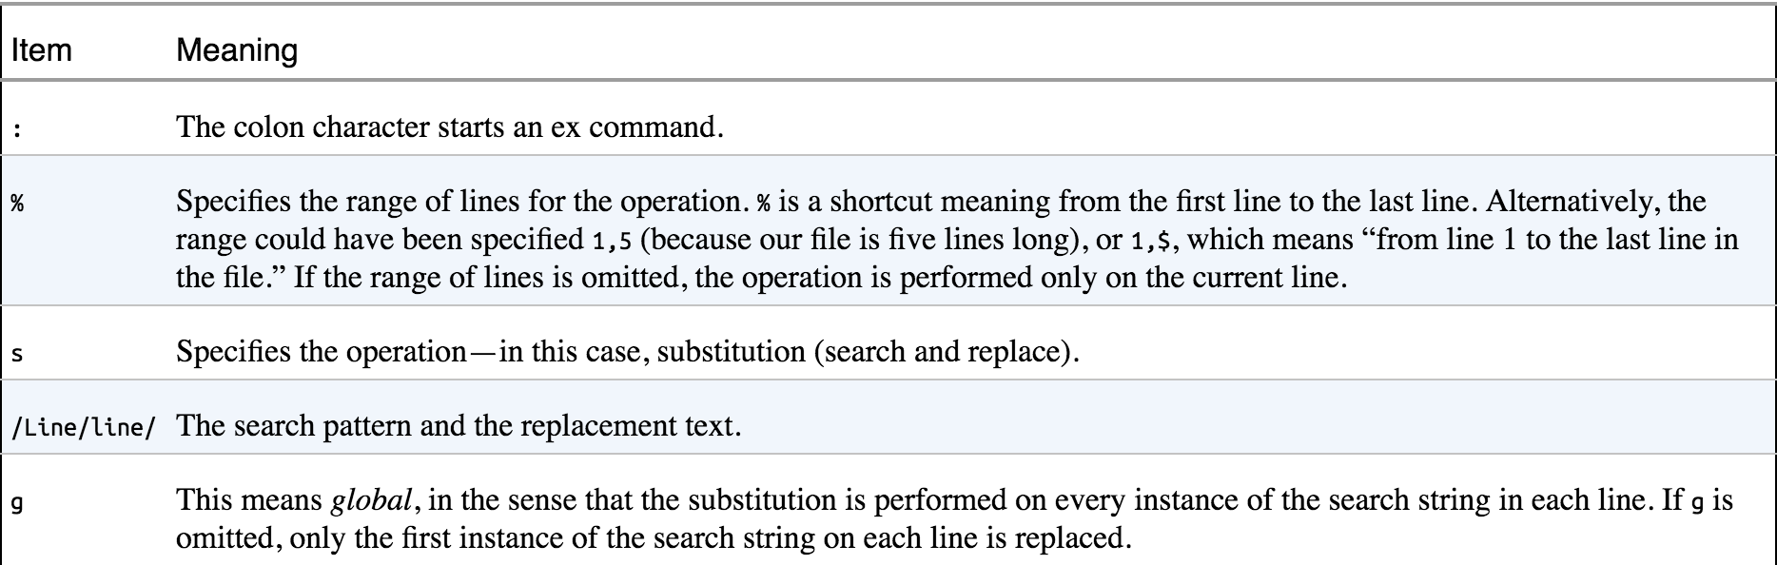
Searching and replacing
Within a line
Search the next occurrence of a character = f, to repeat use ;
The entire file and a string
/, repeat with n
Replacing
%S
replace with VI (y/n/a/q/l/^E/^Y)?
Shotts, W. E. (2012). The Linux command line: William Pollock
Notes:
Replacing would be like :%s/<current word>/<word to be replaced>/g … if wyou want confirmation, add c
replace with VI (y/n/a/q/l/^E/^Y)? --> perform/skip/all/quit/this and last/E scroll down Y scroll up

Slide 69
Copying content from one file to another
You can use the traditional copy and paste methods between text
Insert an entire file into another
:r <file name>

Slide 70
Editing Multiple Files
vi file1 file2
:n and :N for the previous and next file respectively
E37: No write since last change (add ! to override)
You can do :n! and it will switch but won´t save your changes
You can see the files you have opened with :buffers … the current file is noted with %
You can move between buffers with :buffer <number>
You can add files for editing
:e <file name>
Notes:
You cannot move from files if the current file contains changes that have not been saved
When using :e you cannot move using :n or :N

Slide 71
Saving our work
:W <filename> (it works as save as)
does not change the name of the file you are editing … you wil continue to edit text.txt not the saved as
ZZ → save and exit VI
Notes:
:w does not change the name of the file you are editing … you wil continue to edit text.txt not the saved as

Slide 72
Resources

Slide 73
Reference
101 and 201 content + exercises: https://apps.na.collabserv.com/wikis/home?lang=en-us#!/wiki/Wcff1575df759_45f5_b1cd_954770cc98d7/page/Linux%20crash%20course%20resources.
Shotts, W. E. (2012). The Linux command line: William Pollock
VI cheat sheet
Filesystem Hierarchy Standard

